Slide 1
UEFA PREDICTOR
Group 79
Andrew Romanchik, Kenny Zheng, Mary-Kate Stone, Erin Wienke, Jakob Larsen

Slide 2
Project Background
UEFA is a yearly international club soccer tournament and is one of the most watched sports tournaments in the world.
Sports have machine learning models to predict the outcomes of games, such as ANN with backpropagation and RNN, and have been used in leagues such as the NFL and NBA.
The models are not effective in capturing long term dependencies between data.
A suggestion to combat that disadvantage is by using a bayesian approach with a system similar to Elo, called Glicko, which predicts strength of tennis players and therefore predict outcomes of tennis matches.
UEFA has more factors than Tennis in that UEFA’s format of teams, player positions, group stage performance, and team knockout stage performance allow for more complex prediction which requires a more precise model.

Slide 3
Problem Definition
As we all have a strong interest in soccer, we want to create a model that helps to accurately predict the team knockout stage.
Despite Soccer being the most popular sport worldwide, it receives less funding for analytics than the NBA and NFL, which are tournaments solely for the United States. Therefore, there are obvious discrepancies in predicting soccer matches.
Additionally, as UEFA is a championship tournament with European teams, it receives less resources than other soccer events such as the World Cup.
A more accurate model could help teams allocate their players, as they know which factors are more important in defining a winning team.
It can also allow a team to see where specific weaknesses lie, therefore allowing them to improve on their deficiencies.

Slide 4
Data Collection
Data Collection (1981-2021): Gathered data on club teams from UEFA, including their final standings (winner, runner-up, etc.) in games.
Points Analysis: Recorded points scored by the winning team and against them in each game.
Location Data: Collected game location data; initially unused, but later incorporated in the second model.
Country Coefficients: Obtained country coefficients for each team to predict performance, used in the second model.
Data Cleaning: Standardized data across years, adapting different point systems, and filled in missing information.
Pre-processing for Model Fit: Modified scoring data to represent point differences between teams, enabling predictions without prior knowledge of the winner.
Numerical Conversion of Team Names: Transformed team names into numerical values for model compatibility.
Home City Data: Included each team's home city to determine match locations (home or away).
Data Splitting for Models: Randomly split data for the first model; used recent years' data for testing in the final model.

Slide 5
Methods
First Model:
Model Type: Implemented a Recurrent Neural Network (RNN) for time series analysis.
Temporal Dependencies: Chose RNN for its ability to capture temporal patterns in data.
Library Used: Utilized TensorFlow for model implementation.
Flexible Architecture: TensorFlow provided pre-existing architecture for simple RNN, GRU, and LSTM.
Code Efficiency: Allowed for easy alteration of neural network types without significant code changes.
Iterative Approach: Ensured initial results while retaining flexibility for future model iterations.
Second Model:
Continued RNN Use: Employed an RNN with TensorFlow, similar to the first model.
Enhanced Layers: Added two LSTM layers with batch normalization.
Model Expansion: Increased size of LSTM layers for complex data handling.
Batch Normalization: Incorporated batch normalization to stabilize training.
Data Normalization: Normalized features to prevent dominance by a subset of features.
Advanced Predictions: Achieved more accurate predictions, surpassing the basic +/- 1 goal predictions of the first model.

Slide 6
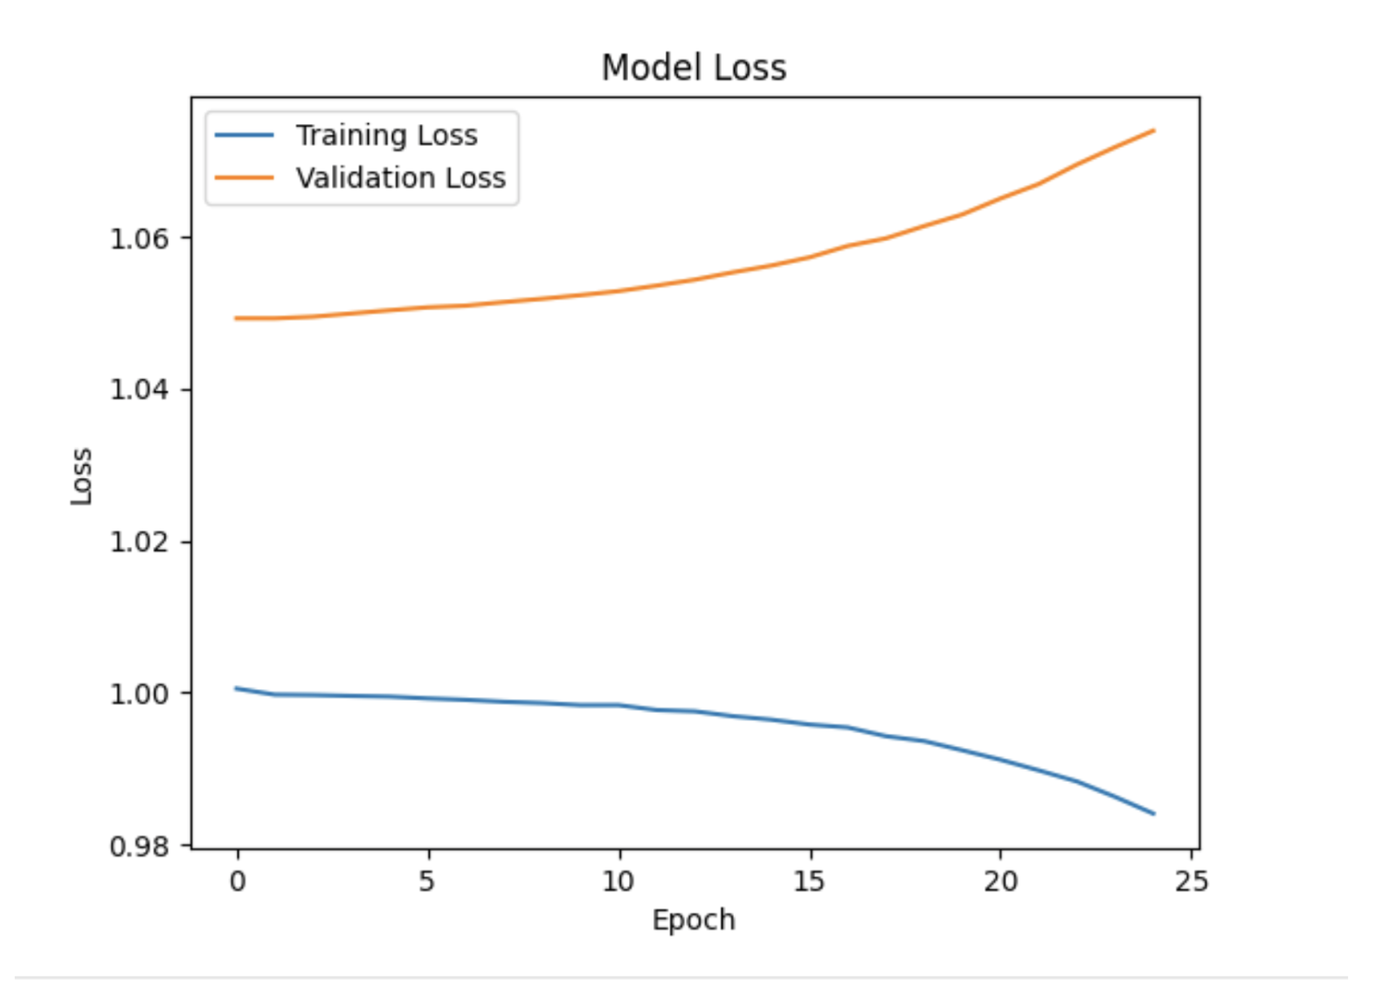
Results
Model 1:
Primary Prediction Method: Used past games to predict the score differential.
Mean Squared Error (Training Set): Achieved a mean squared error of 0.9976.
Loss Per Epoch: Consistently observed a loss of approximately 0.999 in each iteration.
Testing Data Performance: Model performed similarly on testing data, which was a random sample.
Future Data Split Strategy: Plans to use the most recent years for testing and past years for training in future iterations.
Figure indicates that after Epoch 15, training loss decreases while validation loss increases
Indicates overfitting

Slide 7
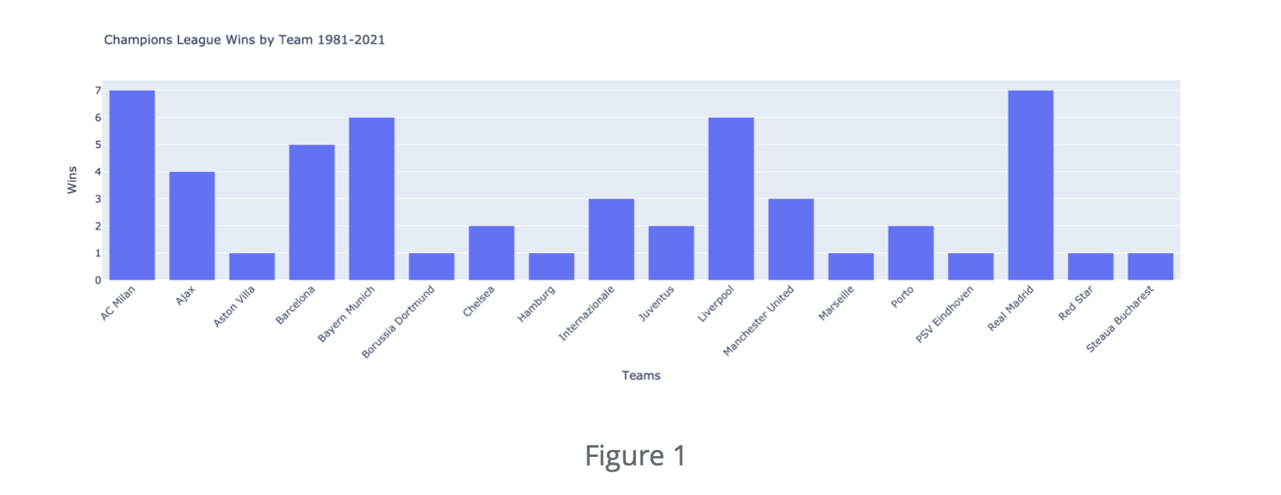
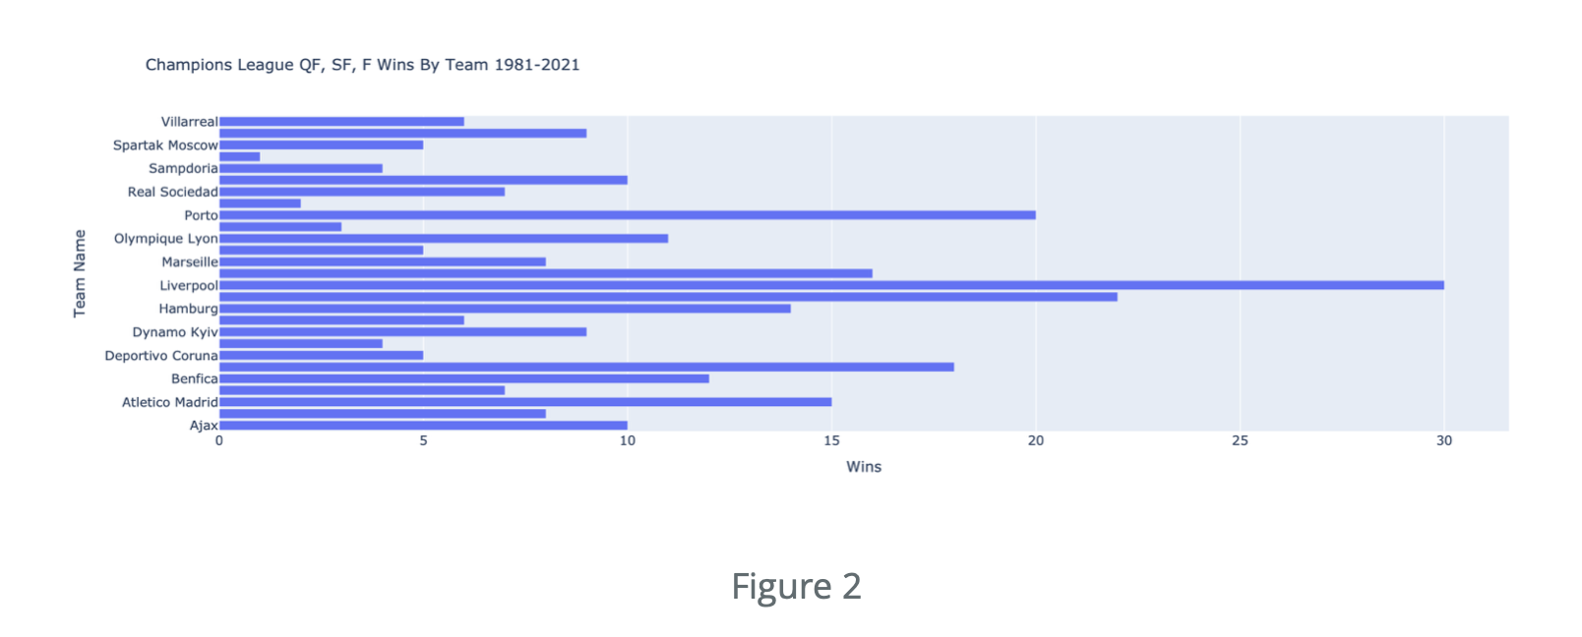
Results (Continued)
Past Performance as Indicator: Statistical analysis suggests past performance strongly predicts future team performance.
Data Visualization Confirmation: A plot of the original data (Figure 1) supports this hypothesis.
Recurrent Team Participation: Shows consistent participation of the same teams in the tournament each year.
Consistent Winners: Indicates a pattern of these recurring teams frequently winning.

Slide 8
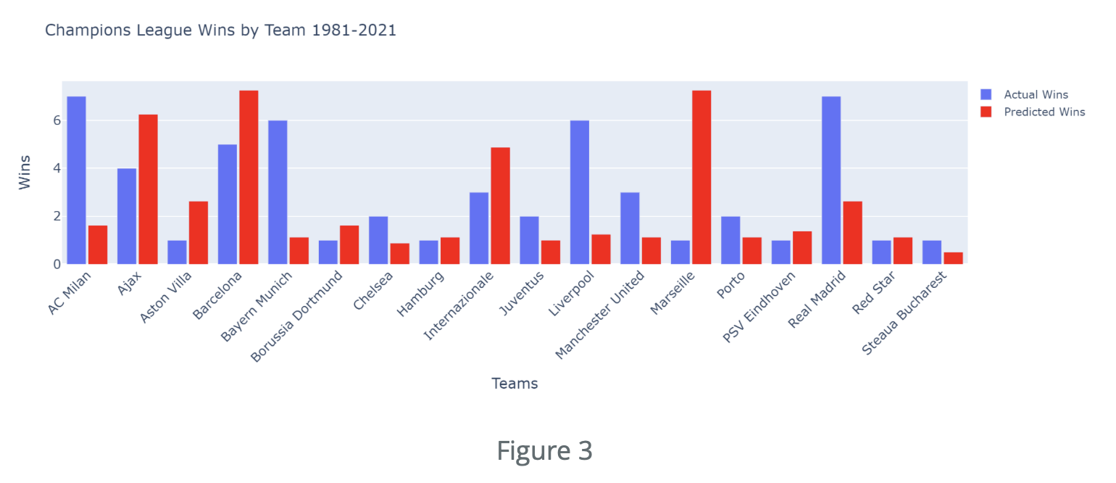
Results (Continued)
Model's Predictive Accuracy: Figure 3 illustrates the relative accuracy of the model in predicting match outcomes.
Match Prediction Method: Model predicted results by matching each team against all others.
Scaling Predictions: Wins predicted by the model were scaled to the average number of matches played by each team.
Partial Accuracy: About half of the teams showed similar results between model predictions and actual outcomes.
Notable Discrepancies: Significant differences in predictions for teams like AC Milan, Bayern Munich, Liverpool, and Marseille.
Current Limitation: Model primarily predicts score differentials within +/- 1 goal.
Future Improvement Goals: Aim to refine feature normalization and develop a model yielding more realistic soccer match scores.
Accuracy Constraints: Model's accuracy currently limited by the range of input features used.

Slide 9
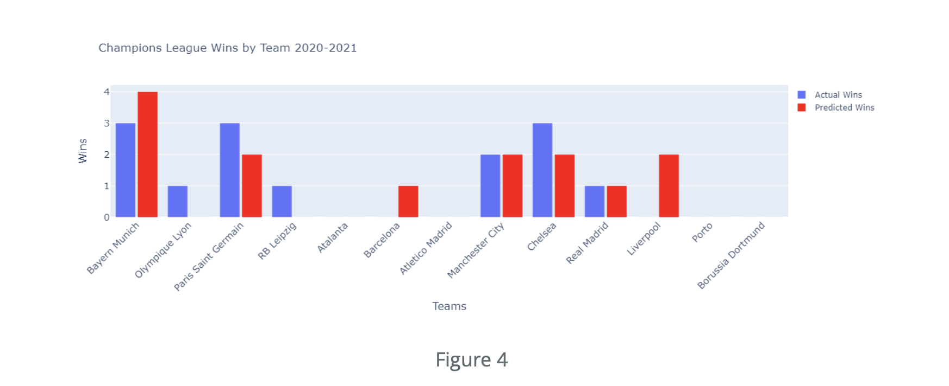
Results (Continued)
Second Model's Accuracy: Figure 4 highlights the improved accuracy of the second model.
Prediction of Knockout Stages: Model tested on 2020 and 2021 knockout stage matches, which were not included in training.
Model Predictions vs. Actual Results: Recorded predictions closely matched actual results, with all being within +/- 1 win.
Exception of Liverpool: Model failed to predict Liverpool's underperformance, likely due to their historically strong record.

Slide 10
Conclusion
Future Considerations: Plan to account for factors like player retention, travel distance to the stadium, and individual game analysis.
Weighting Recent Seasons: Intend to adjust model to give more relevance to recent seasons for future predictions.
Incorporating Country Coefficients: Exploring the use of country coefficients based on wins, losses, and points for more accurate predictions.

Slide 11
References
[1] R. P. Bunker and F. Thabtah, “A machine learning framework for sport result prediction,”
Applied Computing and Informatics, vol. 15, no. 1, pp. 27–33, 2019.
doi:10.1016/j.aci.2017.09.005
[2] Q. Zhang et al., “Sports match prediction model for training and exercise using
attention-based LSTM network,” Digital Communications and Networks, vol. 8, no. 4,
pp. 508–515, 2022. doi:10.1016/j.dcan.2021.08.008
[3] J. C. Yue, E. P. Chou, M.-H. Hsieh, and L.-C. Hsiao, “A study of forecasting tennis matches
via the GLICKO model,” PLOS ONE, vol. 17, no. 4, Apr. 2022.
doi:10.1371/journal.pone.0266838

